Slide 1

NTI FINAL PROJECT
Data-Driven Clinical Insights for Smarter Population Health Decisions
A full analytics pipeline — Python · SQL · Excel · Power BI · Tableau · Streamlit — turning raw health records into dashboards and an interactive app healthcare teams can act on.

Slide 2

Data-Driven Clinical Insights for Smarter Population Health Decisions

Slide 3
AGENDA
Table of Contents
What we'll walk through in this defense, section by section.
1
Introduction & Team
7
Excel Dashboard
Who built MediSights and the story of the project.
The Health Overview workbook and its 12 charts.
2
Project Workflow & Tech Stack
8
Power BI Dashboards
The six-tool pipeline from raw data to app.
Cardiometabolic, Cholesterol, and Lifestyle views.
3
Dataset Overview & Statistics
9
SQL Server & DAX Measures
4,155 records and the population's headline numbers.
Business questions in T-SQL and Power BI measures.
4
Dataset Columns & Data Structure
10
Tableau & Streamlit
Original fields vs. engineered analytical variables.
The visual-exploration and interactive-app layers.
5
Data Quality & Preprocessing
11
Key Findings & Recommendations
Cleaning, outlier handling, and validation in Python.
What the data shows, and what to do about it.
6
Python — EDA, Features & ML
12
Final Value & Conclusion
Notebook link and the modeling approach.
Why this is an end-to-end analytics solution.
MediSights — Agenda
03 / 45

Slide 4

PROJECT CODE
Explore the Python Engine Behind MediSights
All data cleaning, preprocessing, and machine learning for this project were built in Python. The complete source code, notebooks, and scripts live in the GitHub repository below — this is the home for everything related to the project.
GH
GITHUB REPOSITORY
MohamedGaballah18/Health-Data-Analysis-Project
github.com/MohamedGaballah18/Health-Data-Analysis-Project
Data Cleaning
EDA
Feature Engineering
ML Modeling
MediSights — Project Code
04 / 45

Slide 5
PROJECT WORKFLOW
How We Built MediSights
From raw records to an interactive app — the eight-stage pipeline behind this project.
1
2
3
4
Data Collection
Data Cleaning (Python)
Machine Learning
SQL Queries
Gathering the raw population health dataset from source records.
Handling missing values, outliers, and inconsistent formatting.
Building models to explore health risk patterns in the data.
Answering structured business questions with SQL Server.
5
6
7
8
Excel Dashboard
Power BI Dashboards
Tableau Workbook
Streamlit App
Building the Health Overview dashboard in Excel.
Building three interactive analytical dashboards.
Adding a visual, exploration-first layer on the same data.
Packaging the analysis into a browser-based interactive app.
MediSights — Project Workflow
05 / 45

Slide 6
ABOUT THE DATASET
Dataset Overview & Statistics
4,155 population health records, cleaned and engineered for end-to-end analysis.
MediSights is built on a population health dataset that started as 4,157 individual records and was cleaned in Python to 4,155 records across 10 original fields. Five engineered analytical variables were added on top, and the same set of numbers is reused consistently across SQL, Excel, Power BI, Tableau, and the Streamlit app.
4,155
53.30 yrs
27.03 kg/m²
108.96 mmHg
Total Records
Average Age
Average BMI
Avg Systolic BP
Cleaned population size
Mean across the population
Population-wide mean
Notebook df.describe() mean
81.85 mmHg
193.19 mg/dL
29.72%
65.78%
Avg Diastolic BP
Avg Total Cholesterol
Smoking Rate
BMI ≥ 25
Notebook df.describe() mean
Population-wide mean
Confirmed: notebook + Tableau
Overweight + Obese, confirmed
Smoking rate and BMI≥ 25 are now verified against the executed notebook (notebook_results.py) and match the Tableau workbook exactly (1,235/4,155 smokers; 2,733/4,155 overweight+obese). The Excel homepage summary card (26.14% / 56.15%) reflects a stale/cached calculation and should be refreshed to match the values above.
MediSights — Dataset Overview
06 / 45

Slide 7
ABOUT THE DATASET
Dataset Columns & Data Structure
Ten original fields, organized into four categories, plus five confirmed engineered variables.
A. DEMOGRAPHIC
B. CLINICAL / CARDIOMETABOLIC
• Age — individual's age in years
• Age_Group — engineered age band (18-29 … 70+)
• BMI, Systolic_BP, Diastolic_BP
• Total_Cholesterol, HDL_Cholesterol, LDL_Cholesterol
• Triglycerides
C. LIFESTYLE
D. ENGINEERED / ANALYTICAL (5, confirmed)
• Smoking_Status — smoker / non-smoker
• Physical_Activity_Level — low / moderate / high
• BP_Risk_Category, BMI_Category
• Cholesterol_Ratio, Pulse_Pressure
• Age_Group
Confirmed from notebook_results.py: raw load is 4,157 rows x 11 columns; after dropping the Unnamed: 0 CSV index and removing 2 duplicates, the cleaned table is 4,155 x 10, then exactly 5 engineered features are added for a final 15 columns. Power BI / Excel extracts also carry a few tool-side calculated fields (e.g. BMI_Age_Interaction, Cholesterol_Category, Health_Risk_Score, Risk_Tier) built on top of these 15 for dashboard convenience.
MediSights — Dataset Columns
07 / 45

Slide 8
ABOUT THE DATASET
Data Quality & Preprocessing
Real cleaning results from the executed notebook — nothing here is estimated.
4,157 → 4,155
121
2
47
Rows In / Out
Missing Values Found
Duplicate Rows Removed
Invalid BP Rows Fixed
Raw load (4,157 x 11) to cleaned table (4,155 x 10)
Detected via df.isnull().sum() before imputation
Exact duplicate records dropped
Systolic < Diastolic readings swapped back
IQR OUTLIER CAPPING BOUNDS (SECTION 5)
Age
BMI
Systolic_BP
Diastolic_BP
-16.50 – 123.50
13.58 – 40.44
81.95 – 135.89
59.95 – 103.80
Total_Cholesterol
HDL_Cholesterol
LDL_Cholesterol
Triglycerides
148.42 – 237.83
23.90 – 50.52
178.17 – 253.39
191.49 – 306.71
MediSights — Data Quality
08 / 45

Slide 9
PYTHON — EDA & KPIs
Exploratory Analysis & the 9-KPI Table
Real, notebook-computed KPIs — the Section-12 KPI Analysis table, printed directly from the executed cells.
59.78%
27.87%
29.72%
20.39%
Elevated BP Risk Rate
Obesity Prevalence
Smoking Prevalence
Physical Inactivity
Systolic ≥130 or Diastolic ≥80
BMI ≥30 (WHO standard)
Share of population who smoke
Share reporting 'low' activity
5.29
59.81%
0.00%
100.00%
Avg Chol. Ratio
Elevated Chol. Ratio
High Total Chol. (≥240)
Data Completeness
Total:HDL, cardiovascular risk score
Share with Total:HDL ratio > 5
0% — IQR capping bounded max at 237.83
After Section 5/8 cleaning
STRONGEST CORRELATION (SECTION 10 HEATMAP)
Total_Cholesterol ↔ LDL_Cholesterol: r = 0.69 (by far the strongest pair). Age ↔ Systolic_BP is weak-to-moderate at r = 0.18, confirming BP screening shouldn't rely on age alone.
MediSights — Python — EDA & KPIs
09 / 45

Slide 10
PYTHON — BUSINESS QUESTIONS
Business & Health Questions (1 of 2)
Six real questions investigated in the notebook — finding, evidence, and recommendation for each.
Q1. Does smoking associate with a higher BMI?
Finding: Avg BMI is nearly identical: non-smoker 27.06 vs smoker 26.94.
Interpretation: Smoking status alone does not distinguish body-weight risk here.
Recommendation: Treat smoking and obesity as separate, independent risk factors.
Q2. How does systolic BP change with age?
Finding: Positive but modest correlation: r = 0.18 between Age and Systolic BP.
Interpretation: Age explains only part of BP variation — a contributing factor, not the sole one.
Recommendation: Combine age with BMI and lipid markers when prioritizing BP screening.
Q3. Does activity level associate with lower BMI?
Finding: Median BMI is nearly flat: low 27.00, moderate 27.03, high 27.03.
Interpretation: Self-reported activity is not a strong standalone differentiator of BMI.
Recommendation: Pair activity tracking with direct BMI measurement, not as a substitute.
MediSights — Business Questions
10 / 45

Slide 11
PYTHON — BUSINESS QUESTIONS
Business & Health Questions (2 of 2)
The remaining three questions — the sharpest segmentation signals in the dataset.
Q4. Does elevated BP risk differ by smoking status?
Finding: Elevated BP risk: 60.4% of non-smokers vs 58.4% of smokers — very similar.
Interpretation: Elevated BP risk is widespread across the population, not concentrated in smokers.
Recommendation: Screen for blood pressure broadly, not just among smokers.
Q5. Which BMI category carries the highest BP-risk rate?
Finding: Elevated BP risk rises steadily: Underweight 33.9% → Normal 50.4% → Overweight 60.7% → Obese 72.5%.
Interpretation: BMI category is a far sharper, more actionable gradient than smoking status for BP risk.
Recommendation: Prioritize BMI-based screening tiers, with fastest follow-up for the Obese category.
Q6. Which age group carries the highest avg. total cholesterol?
Finding: Cholesterol rises steadily by age: 187.66 (18-29) up to 198.66 (70+).
Interpretation: Older age bands carry the highest average lipid burden.
Recommendation: Allocate proportionally more lipid-screening resources to older age groups.
MediSights — Business Questions
11 / 45

Slide 12
PYTHON — MACHINE LEARNING
Predicting Elevated BP Risk
Target: BP_Risk_Category (Elevated/High=1, Normal=0) — real train/test results, Sections 13-15.
METRIC
Log. Reg.
Rand. Forest
MODEL SETUP
Accuracy
0.635
0.628
Features: Age, BMI, Total/HDL/LDL Cholesterol, Triglycerides, Smoking_Status, Physical_Activity_Level
Train / Test: 3,324 / 831 rows, stratified split
Class balance: 59.8% Elevated / 40.2% Normal (same in both splits)
Naive baseline: 59.8% accuracy (majority class)
Precision
0.646
0.635
Recall
0.865
0.889
F1-Score
0.739
0.741
ROC-AUC
0.639
0.640
BEST MODEL: LOGISTIC REGRESSION
Edges out Random Forest on Accuracy, Precision, and ROC-AUC; RF has slightly higher Recall/F1. Both clear the 59.8% naive baseline, confirming real learned signal.
TOP PREDICTOR: BMI
BMI ranks #1 in Random Forest importance and has by far the largest coefficient in Logistic Regression — agreement across both models is a strong signal (not proof of causation).
MediSights — Machine Learning
12 / 45

Slide 13
ANALYTICS DASHBOARDS
Four Dashboards, One Complete Health Picture
One Excel dashboard and three Power BI dashboards, each built for a different lens on the same population.
1
Excel
2
Power BI
Health Overview
Cardiometabolic Profile
Overall population health profile
Blood pressure risk across age groups
3
Power BI
4
Power BI
Cholesterol Risks
Lifestyle & Health Risk
Cholesterol and blood lipid risk
Lifestyle factors and health outcomes
MediSights — Dashboards Overview
13 / 45

Slide 14
DASHBOARD 01 — EXCEL
Business Questions Answered with SQL
1
Easy
How many people are included in the dataset?
2
Easy
How many people are smokers and how many are non-smokers?
3
Easy
How many people belong to each physical activity level?
4
Medium
How are people distributed across BMI categories such as Underweight, Normal, Overweight, and Obese?
5
Medium
How many people have desirable total cholesterol and how many have high total cholesterol?
6
Medium
How many people have normal systolic blood pressure and how many have elevated or high systolic blood pressure?
7
Hard
What percentage of the population falls into each BMI-based health category?
MediSights — Health Overview Dashboard
19 / 45
Question mix: 3 Easy · 3 Medium · 1 Hard — KPIs are tracked separately from these seven SQL business questions.

Slide 15
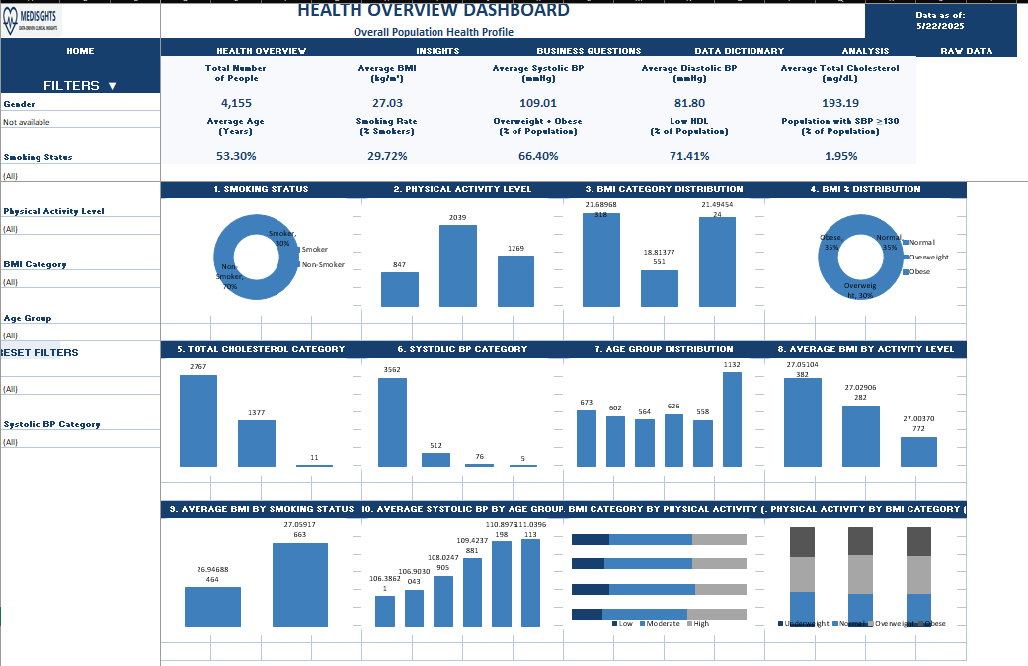
DASHBOARD 01 — EXCEL
Health Overview Dashboard
Overall Population Health Profile
MediSights — Health Overview Dashboard
14 / 45

Slide 16
DASHBOARD 01 — EXCEL
Purpose & Target Audience
DASHBOARD GOAL
Provide decision makers with a high-level view of the population's overall health status and highlight the most important health indicators.
WHO USES THIS DASHBOARD
1
2
3
4
Healthcare Managers
Public Health Decision Makers
Health Program Coordinators
Senior Management
MediSights — Health Overview Dashboard
15 / 45

Slide 17
DASHBOARD 01 — EXCEL
Key Performance Indicators
The headline numbers this dashboard puts front and center, and why each one matters.
4,155
27.03 kg/m²
109.01 mmHg
81.80 mmHg
193.19 mg/dL
Total Number of People
Average BMI
Average Systolic BP
Average Diastolic BP
Average Total Cholesterol
Shows the size of the analyzed population
Summarizes the overall BMI level
Summarizes the average upper blood pressure
Summarizes the average lower blood pressure
Summarizes the overall cholesterol level
MediSights — Health Overview Dashboard
16 / 45

Slide 18
DASHBOARD 01 — EXCEL
Reading the Charts — Part 1
What each visual on this dashboard shows and why it's there.
1
1. Smoking Status
2
2. Physical Activity Level
3
3. BMI Category Distribution
Donut split of smokers (30%) vs. non-smokers (70%) across the population.
Bar chart comparing people across Low, Moderate, and High activity levels.
Counts of people across Underweight, Normal, Overweight, and Obese categories.
4
4. BMI % Distribution
5
5. Total Cholesterol Category
6
6. Systolic BP Category
Donut showing the share of Normal, Overweight, and Obese classifications.
Bar chart of Desirable, Borderline High, and High cholesterol groups.
Bar chart grouping people by Normal, Elevated, and High systolic pressure.
MediSights — Health Overview Dashboard
17 / 45

Slide 19
DASHBOARD 01 — EXCEL
Reading the Charts — Part 2
What each visual on this dashboard shows and why it's there.
1
7. Age Group Distribution
2
8. Average BMI by Activity Level
3
9. Average BMI by Smoking Status
Population count across six age bands, from 18-29 up to 70+.
Compares average BMI across Low, Moderate, and High activity groups.
Compares average BMI between smokers and non-smokers.
4
10. Average Systolic BP by Age Group
5
11. BMI Category by Physical Activity
6
12. Physical Activity by BMI Category
Shows systolic pressure rising steadily as age increases.
100% stacked view of BMI categories within each activity level.
100% stacked view of activity levels within each BMI category.
MediSights — Health Overview Dashboard
18 / 45

Slide 20
DASHBOARD 02 — POWER BI
Business Questions Answered with SQL
1
Easy
What are the minimum and maximum systolic blood pressure values?
2
Easy
What are the minimum and maximum diastolic blood pressure values?
3
Easy
How many people have systolic blood pressure greater than or equal to 130?
4
Medium
How many people belong to each age group: 18-29, 30-39, 40-49, 50-59, and 60+?
5
Medium
How many people have high blood pressure in each age group?
6
Medium
How many people have normal blood pressure compared with elevated or high blood pressure?
7
Hard
Which age group has the highest percentage of people classified as having high blood pressure?
MediSights — Cardiometabolic Profile
24 / 45
Question mix: 3 Easy · 3 Medium · 1 Hard — KPIs are tracked separately from these seven SQL business questions.

Slide 21
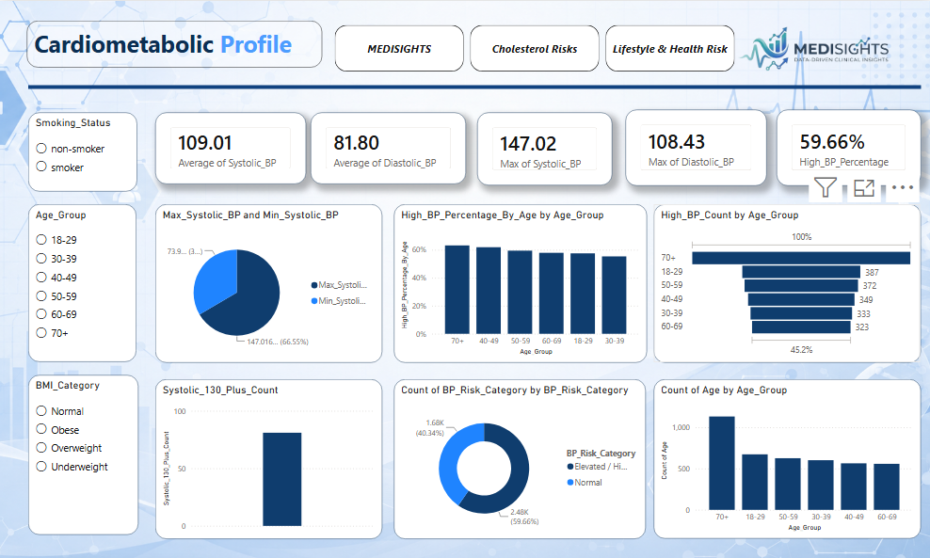
DASHBOARD 02 — POWER BI
Cardiometabolic Profile
Blood Pressure Risk Across Age Groups
MediSights — Cardiometabolic Profile
20 / 45

Slide 22
DASHBOARD 02 — POWER BI
Purpose & Target Audience
DASHBOARD GOAL
Identify age groups with higher blood pressure risk and show how blood pressure status changes across different stages of age.
WHO USES THIS DASHBOARD
1
2
3
4
Clinical Risk Analysts
Healthcare Professionals
Preventive Care Teams
Health Risk Assessment Teams
MediSights — Cardiometabolic Profile
21 / 45

Slide 23
DASHBOARD 02 — POWER BI
Key Performance Indicators
The headline numbers this dashboard puts front and center, and why each one matters.
109.01
81.80
147.02
108.43
59.66%
Average Systolic BP
Average Diastolic BP
Highest Systolic BP
Highest Diastolic BP
High BP Percentage
Summarizes the average upper blood pressure value
Summarizes the average lower blood pressure value
Highlights the maximum observed systolic value
Highlights the maximum observed diastolic value
Shows the share of the population with high blood pressure
MediSights — Cardiometabolic Profile
22 / 45

Slide 24
DASHBOARD 02 — POWER BI
Reading the Charts
What each visual on this dashboard shows and why it's there.
1
Max & Min Systolic BP
2
High BP % by Age Group
3
High BP Count by Age Group
Pie chart contrasting the highest and lowest systolic readings recorded.
Bar chart showing high blood pressure risk climbing with age, peaking at 70+.
Horizontal bars ranking raw high-BP case counts across every age band.
4
Systolic 130+ Count
5
BP Risk Category Split
6
Population by Age Group
Single bar isolating everyone with systolic pressure at or above 130 mmHg.
Donut dividing the population into Normal (59.7%) vs. Elevated/High (40.3%) risk.
Bar chart of total headcount within each of the six age groups.
MediSights — Cardiometabolic Profile
23 / 45

Slide 25
DASHBOARD 03 — POWER BI
Business Questions Answered with SQL
1
Easy
What is the highest total cholesterol value in the dataset?
2
Easy
What is the lowest LDL cholesterol value in the dataset?
3
Easy
How many people have HDL cholesterol below 40?
4
Medium
How many people fall into the Desirable, Borderline High, and High total cholesterol categories?
5
Medium
How many people have LDL cholesterol classified as High or Very High?
6
Medium
How does the number of people with high total cholesterol differ between smokers and non-smokers?
7
Hard
Which age group has the highest percentage of people with high LDL cholesterol?
MediSights — Cholesterol Risks
29 / 45
Question mix: 3 Easy · 3 Medium · 1 Hard — KPIs are tracked separately from these seven SQL business questions.

Slide 26
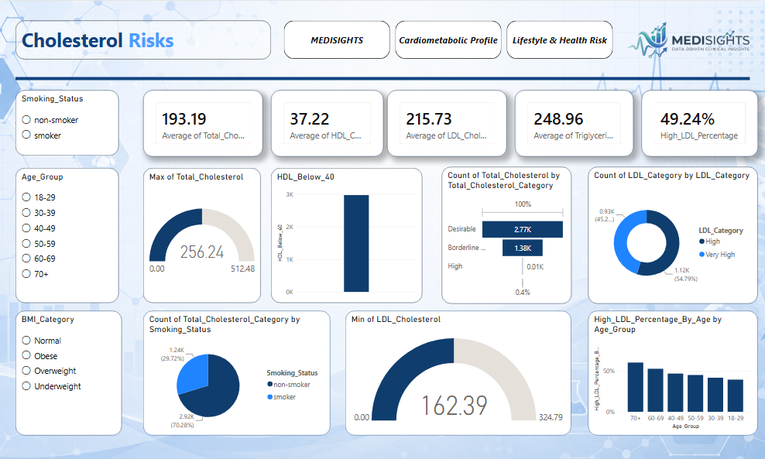
DASHBOARD 03 — POWER BI
Cholesterol Risks
Cholesterol and Blood Lipid Risk
MediSights — Cholesterol Risks
25 / 45

Slide 27
DASHBOARD 03 — POWER BI
Purpose & Target Audience
DASHBOARD GOAL
Monitor cholesterol and blood lipid indicators to identify groups with potentially higher cardiovascular risk and determine where attention is needed.
WHO USES THIS DASHBOARD
1
2
3
4
Cardiovascular Risk Analysts
Clinical Nutrition Teams
Health Screening Teams
Healthcare Researchers
MediSights — Cholesterol Risks
26 / 45

Slide 28
DASHBOARD 03 — POWER BI
Key Performance Indicators
The headline numbers this dashboard puts front and center, and why each one matters.
193.19
37.22
215.73
248.96
49.24%
Average Total Cholesterol
Average HDL Cholesterol
Average LDL Cholesterol
Average Triglycerides
High LDL Percentage
Summarizes the overall cholesterol level
Summarizes the average HDL (“good”) cholesterol level
Summarizes the average LDL (“bad”) cholesterol level
Summarizes the average triglyceride level
Shows the share of the population with high LDL
MediSights — Cholesterol Risks
27 / 45

Slide 29
DASHBOARD 03 — POWER BI
Reading the Charts
What each visual on this dashboard shows and why it's there.
1
Cholesterol Range Indicators
2
HDL Below 40 Count
3
Total Cholesterol Category Split
Gauges showing the highest total cholesterol (256.24) and lowest LDL cholesterol (162.39) on record.
Bar isolating everyone whose HDL (“good” cholesterol) falls under the healthy 40 threshold.
Bar chart across Desirable (2.77K), Borderline High (1.38K), and High groups.
4
LDL Category Split
5
Cholesterol by Smoking Status
6
High LDL % by Age Group
Donut dividing the population between High and Very High LDL classifications.
Donut comparing high-cholesterol prevalence between smokers and non-smokers.
Bar chart tracking how high-LDL prevalence shifts across age bands.
MediSights — Cholesterol Risks
28 / 45

Slide 30
DASHBOARD 04 — POWER BI
Business Questions Answered with SQL
1
Easy
How many people are smokers and how many are non-smokers?
2
Easy
How many people belong to Low, Moderate, and High physical activity levels?
3
Easy
How many people have a BMI greater than or equal to 25?
4
Medium
For each physical activity level, how many people are Overweight or Obese?
5
Medium
How does the number of people with high LDL cholesterol differ between smokers and non-smokers?
6
Medium
For each physical activity level, how many people have high triglycerides?
7
Hard
Which physical activity level has the highest percentage of people with BMI greater than or equal to 25?
MediSights — Lifestyle & Health Risk
34 / 45
Question mix: 3 Easy · 3 Medium · 1 Hard — KPIs are tracked separately from these seven SQL business questions.

Slide 31
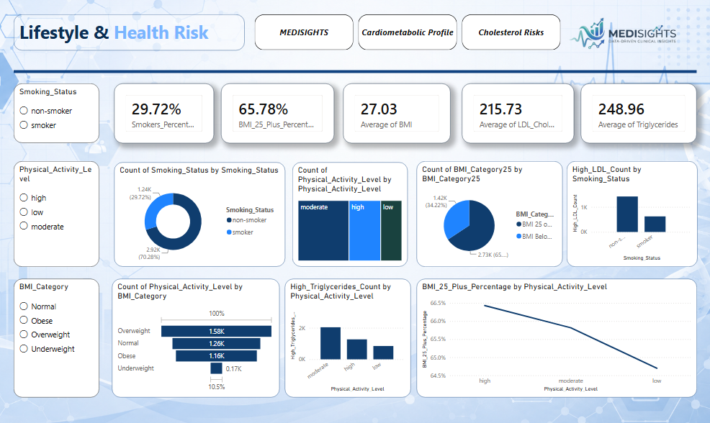
DASHBOARD 04 — POWER BI
Lifestyle & Health Risk
Lifestyle Factors and Health Outcomes
MediSights — Lifestyle & Health Risk
30 / 45

Slide 32
DASHBOARD 04 — POWER BI
Purpose & Target Audience
DASHBOARD GOAL
Explore how lifestyle characteristics such as smoking and physical activity are associated with BMI, LDL cholesterol, and triglyceride levels.
WHO USES THIS DASHBOARD
1
2
3
4
Lifestyle and Wellness Analysts
Health Promotion Teams
Community Health Planners
Wellness Program Managers
MediSights — Lifestyle & Health Risk
31 / 45

Slide 33
DASHBOARD 04 — POWER BI
Key Performance Indicators
The headline numbers this dashboard puts front and center, and why each one matters.
29.72%
65.78%
27.03
215.73
248.96
Percentage of Smokers
BMI 25+ Percentage
Average BMI
Average LDL Cholesterol
Average Triglycerides
Shows the share of smokers in the population
Shows the share classified as overweight or above
Summarizes the overall BMI level
Summarizes the average LDL level
Summarizes the average triglyceride level
MediSights — Lifestyle & Health Risk
32 / 45

Slide 34
DASHBOARD 04 — POWER BI
Reading the Charts
What each visual on this dashboard shows and why it's there.
1
Smoking Status Split
2
Physical Activity Level Split
3
BMI 25+ Split
Donut showing non-smokers (70.3%) versus smokers (29.7%) in the population.
100% bar comparing headcount across Low, Moderate, and High activity levels.
Donut isolating the 65.8% of people classified with BMI at or above 25.
4
High LDL Count by Smoking Status
5
Physical Activity by BMI Category
6
Triglycerides & BMI Trend by Activity
Bar chart comparing high-LDL cases between non-smokers and smokers.
100% stacked bar showing activity-level mix within Overweight, Normal, Obese, and Underweight groups.
Bar and line combo linking high-triglyceride counts and BMI 25+ share to activity level, both declining as activity rises.
MediSights — Lifestyle & Health Risk
33 / 45

Slide 35
TECHNICAL DEMONSTRATION
SQL Server & Power BI Measures
A quick look under the hood — shown live in SQL Server Management Studio and the Power BI Fields pane.
SQL SERVER
POWER BI DAX MEASURES
Every KPI and business question in this deck was answered directly against the cleaned_health_data table, one T-SQL script per dashboard (DASHBOARD1-4).
Every KPI card across the three Power BI dashboards is powered by its own DAX measure, kept separate in the Fields pane rather than computed inline.
Blood Pressure
-- KPI 1: Average Systolic Blood Pressure
SELECT ROUND(AVG(Systolic_BP), 2)
AS Average_Systolic_BP
FROM cleaned_health_data;
Average of Systolic_BP · Average of Diastolic_BP · Max of Systolic_BP · High_BP_Percentage
Cholesterol
Average of Total_Cholesterol · Average of HDL_Cholesterol · Average of LDL_Cholesterol · High_LDL_Percentage
The complete .sql files open directly in SQL Server Management Studio (no need to run) to show the full KPI + business-question set live.
Lifestyle
Smokers_Percentage · BMI_25_Plus_Percentage · Average of BMI
Measure names shown are the labels visible on each dashboard's KPI cards; formulas are opened live in the Measures pane.
MediSights — SQL & DAX
35 / 45

Slide 36
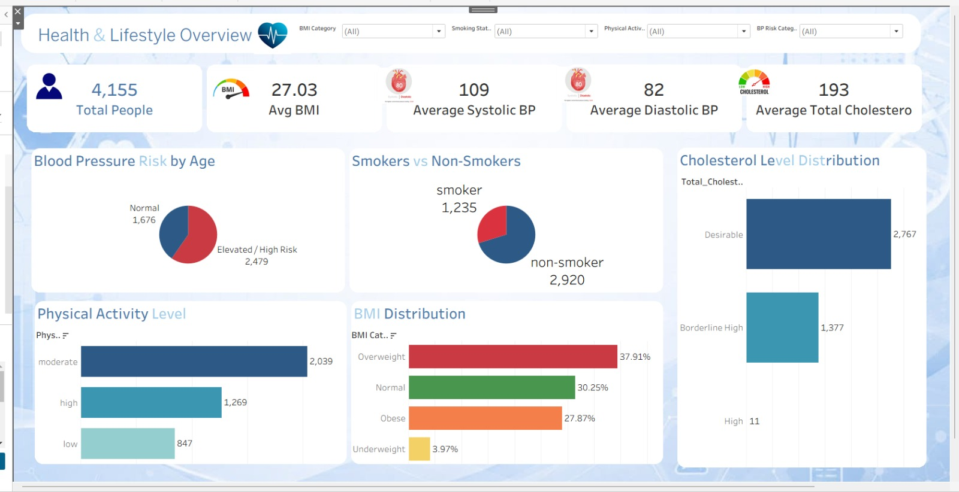
EXTENDED ANALYTICS LAYER
Tableau & Streamlit
Two more lenses on the same population dataset — visual exploration and an interactive app.
TABLEAU — HEALTH & LIFESTYLE OVERVIEW
STREAMLIT APP
5 pages, live at:
final-project-nti-efqn6ed7gmx68o3rxtczpj.streamlit.app
🏠 Overview — headline KPIs + best-model callout
📊 Analytics Dashboard — live filters, distributions, correlation heatmap, data explorer + CSV download
💡 Business Insights — the 6 business questions, each with chart + answer + recommendation
🤖 Machine Learning — model comparison table, best-model callout, feature importance
ℹ️ About — project narrative, dataset summary, methodology, tech stack
Every number traces back to notebook_results.py or a live-uploaded CSV — nothing is invented.
Confirms the notebook exactly: 4,155 people · 1,235 smokers / 2,920 non-smokers (29.72%) · BMI mix 37.91% overweight + 27.87% obese = 65.78% — and gives a second, independent read on BP risk by age.
MediSights — Tableau & Streamlit
36 / 45

Slide 37
ANALYTICS DASHBOARDS
Who Is Each Tool For?
Four lenses on one population, each suited to a different audience and use case.
TOOL
TARGET AUDIENCE
PURPOSE
Excel
Analysts / Health Program Managers
Quick, filterable health overview and pivot-based reporting
Power BI
BI teams / Clinical decision-makers
KPI monitoring and interactive drill-down across 3 dashboards
Tableau
Analysts / Decision-makers
Visual, exploration-first analysis of the same indicators
Streamlit
End users / Reviewers
No-install, browser-based access to the analysis
Each dashboard was scoped to the questions its audience actually asks — executives get a summary, analysts get drill-down, and end users get a browser-based app.
MediSights — Dashboard Audience
37 / 45

Slide 38
KEY FINDINGS
What the Data Actually Tells Us
Six evidence-based patterns, corrected and confirmed against the executed notebook.
1
Overweight/obesity affects two-thirds of the population
4
Physical activity shows little relationship with BMI
65.78% of the population has BMI ≥ 25 (37.91% overweight + 27.87% obese); average BMI is 27.03 — above the healthy range.
Median BMI is nearly flat across activity levels (low 27.00, moderate 27.03, high 27.03) — activity should be tracked as its own indicator, not a weight proxy.
2
Smoking status is NOT a strong risk differentiator here
5
Age correlates modestly with BP, more clearly with cholesterol
Smokers and non-smokers show nearly identical avg. BMI (26.94 vs 27.06) and elevated-BP-risk rates (58.4% vs 60.4%) — smoking alone doesn't flag this population's BP or weight risk.
Age vs Systolic BP: r = 0.18 (modest). Average total cholesterol rises steadily by age group, from 187.66 (18–29) to 198.66 (70+).
3
BMI is the sharpest gradient for blood-pressure risk
6
Cholesterol fields move together; BMI drives the ML model
Elevated BP risk rises steadily from 33.9% (Underweight) to 72.5% (Obese) — a 38-point spread, far larger than any smoking-based split.
Total and LDL Cholesterol are the dataset's strongest correlation (r = 0.69). In the trained model, BMI is the top predictor of elevated BP risk, ahead of age and lipids.
MediSights — Key Findings
38 / 45

Slide 39
FROM INSIGHT TO ACTION
Insight → Recommendation Map
Every recommendation on the next slide traces back to a specific, notebook-verified pattern.
INSIGHT (VERIFIED)
RECOMMENDATION
BMI ≥ 25 covers 65.78% of the population
Strengthen weight & lifestyle monitoring
BP risk rises from 33.9% (Underweight) to 72.5% (Obese)
Prioritize BMI-tiered BP screening
Smoking shows no meaningful BP/BMI gap (58.4% vs 60.4%)
Screen for BP broadly, not by smoking status
Activity level shows almost no BMI relationship (~27 flat)
Track activity and BMI as separate indicators
Avg. cholesterol rises steadily with age (187.7 → 198.7)
Weight lipid screening toward older age groups
Logistic Regression: BMI is the top predictor of BP risk
Use the model as a supporting screening signal
MediSights — Insight to Action
39 / 45

Slide 40
RECOMMENDATIONS
Turning Insights Into Action
Population-health monitoring recommendations grounded in the notebook's real results.
1
2
3
4
BMI-Tiered BP Screening
Broaden Smoking-Based Screening
Treat Activity as a Separate Metric
Age-Weighted Lipid Screening
Prioritize BP screening by BMI category — risk rises from 33.9% (Underweight) to 72.5% (Obese).
Don't gate BP/BMI screening on smoking status; the notebook shows no meaningful gap between groups.
Track physical activity independently of BMI — the two show almost no relationship in this data.
Allocate more cholesterol-screening resources to older age groups, without excluding younger ones.
5
6
7
8
Cholesterol-Ratio Monitoring
Combined Risk Segmentation
Dashboard-Based Monitoring
Predictive Analytics Support
59.81% of the population has an elevated Total:HDL ratio (>5) — track this alongside LDL alone.
Combine BMI + Age + Cholesterol + BP into unified risk tiers rather than single-factor rules.
Use the Excel, Power BI, and Tableau dashboards for ongoing KPI tracking across the population.
Use the Logistic Regression model (63.5% accuracy, beats the 59.8% baseline) as a supporting signal, not a diagnosis.
These are population-health monitoring recommendations — not individual medical advice.
MediSights — Recommendations
40 / 45

Slide 41
PROJECT VALUE
An End-to-End Analytics Solution
Five layers of value, from describing what happened to letting people act on it.
Descriptive Analytics
What is happening?
Excel, Power BI, and Tableau dashboards summarize the population's health profile.
Diagnostic / Comparative Analysis
Where are the differences?
SQL business questions and chart breakdowns compare groups by age, smoking, and activity.
Predictive Analytics
Can risk be predicted?
Python classification models flag higher-risk profiles from the engineered features.
Business Intelligence
Can decision-makers explore the results?
Interactive Power BI and Tableau filtering supports self-service exploration.
Application
Can users interact with it directly?
The Streamlit app puts the analysis in a browser — no BI license required.
MediSights — Project Value
41 / 45

Slide 42
TECH STACK
Tools Behind the Analysis
Six tools, one continuous pipeline from raw data to an interactive app.
Python
SQL Server
Excel
Data cleaning, preprocessing, and machine learning
Structured querying to answer business questions
Health Overview dashboard and pivot-based analysis
Power BI
Tableau
Streamlit
Interactive Cardiometabolic, Cholesterol, and Lifestyle dashboards
Visual, exploration-first drill-down into the same indicators
Browser-based interactive app for end users and reviewers
MediSights — Tech Stack
42 / 45

Slide 43
PROCESS
Challenges & Key Learnings
CHALLENGES
KEY LEARNINGS
1
Handling missing and inconsistent health records
1
End-to-end pipeline experience, from Python to SQL to BI tools
2
Choosing meaningful thresholds for BMI, blood pressure, and cholesterol risk
2
The importance of designing KPIs around a specific audience
3
Designing four dashboards with a consistent, uncluttered layout
3
Stronger data storytelling and dashboard UX skills
4
Translating raw SQL answers into clear, visual stories
4
Practical experience combining Excel and Power BI in one workflow
MediSights — Challenges & Learnings
43 / 45

Slide 44
CONCLUSION
MediSights: From Raw Data to Real Decisions
This project carries a population health dataset through a complete analytics pipeline — cleaned and modeled in Python, queried with SQL Server, and delivered through one Excel workbook, three Power BI dashboards, a Tableau workbook, and a Streamlit app. Together, these six tools give healthcare managers, clinical analysts, and wellness teams a clear, evidence-based view of population risk — turning raw records into insight that can genuinely support better health decisions.
4,155
6
28
20
People Analyzed
Tools & Apps Used
SQL Business Questions
KPIs Tracked
MediSights — Conclusion
44 / 45

Slide 45
Thank You
Questions & Discussion
MediSights — Data-Driven Clinical Insights · NTI Final Project

